Slide 1
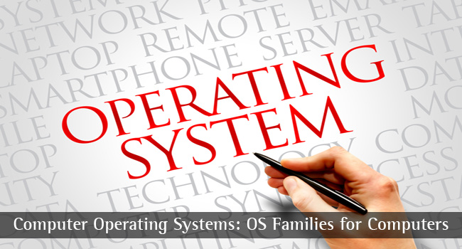
CS-3103 : Operating Systems : Sec-A (NB) :
Deadlocks…..
Operating System Concepts

Slide 2
CSEN3103: 3RD YEAR: SEC-A: Deadlocks
System Model
Deadlock Characterization
Methods for Handling Deadlocks
Deadlock Prevention
Deadlock Avoidance
Deadlock Detection
Recovery from Deadlock
Combined Approach to Deadlock Handling
Operating System Concepts

Slide 3


Approaching Deadlock……
Let us consider the following scenario:
A process P1 is in execution. It requests for a printer. The operating system allocates the printer to process P1. A context switch happens: Process P1 is now in possession of the printer, but it has relinquished the CPU. The CPU is allotted to another process, P2. The process P2 now requests for the printer….
In this situation, for the moment, neither P1 nor P2 can progress, because P1 has the printer but needs the CPU to generate data.
On the other hand P2 has the CPU and can generate data, but needs the printer to print it.
We can say, both processes P1 and P2 are blocked at the moment and are in a deadlock situation.
Deadlock is a situation in a computer system, where a set of processes is blocked, waiting for an event which will never happen.
Starvation can be defined as a situation where a process waits for a resource, which is, for a prolonged time, made available to other processes.
Operating System Concepts

Slide 4
The Deadlock Problem
A set of blocked processes each holding a resource and waiting to acquire a resource held by another process in the set. Couple of examples:
Example -1
  System has 2 printers.
  P₁ and P₂ each hold one printer and each needs another one.
Example-2
  semaphores A and B, initialized to 1
        P₁ P₂
        wait (A); wait(B)
        wait (B); wait(A)
Operating System Concepts

Slide 5
DEADLOCK – Let’s talk about Resource allocation to processes
A computer system has 6 tape drives with n processes competing for them. Each process need 2 tape drives. The maximum value for n for which the system is guaranteed to be deadlock free is: a) 6 b) 5 c) 4 d) 3
5 processes can start with 1 tape drive (each). Processes are executing sequentially in the following way:
2 allocate
1
1
1
1
No Deadlock
P1
P2
P3
P4
P5
2 free
3 free
4 free
5 free
6 free
Operating System Concepts

Slide 6
System Model
Resource types R₁, R₂, . . ., R_{m}
    CPU cycles, memory space, I/O devices
Each resource type R_{i} has W_{i} instances.
Each process utilizes a resource as follows:
  request
  use
  release
Operating System Concepts

Slide 7
Necessary conditions for a Deadlock to occur
Deadlock can arise if the following four conditions hold simultaneously.
Mutual exclusion: A major cause of deadlock is that some resources are not shareable. Therefore, only one process can access such a resource at a time. This is a case of mutual exclusion, where, competing processes mutually exclude each other for the usage of the resource. Example: the chopstick is a non-shareable resource and therefore no two philosophers can simultaneously use the same chopstick.
Hold and wait: a process holding at least one resource is waiting to acquire additional resources held by other processes.
No preemption: a resource can be released only voluntarily by the process holding it, after that process has completed its task.
Circular wait: there exists a set {P₀, P₁, …, P₀} of waiting processes such that P₀ is waiting for a resource that is held by
P₁, P₁ is waiting for a resource that is held by P₂, …, P_{n–1} is waiting for a resource that is held by P_{n}, and P₀ is waiting for a resource that is held by P₀.
Operating System Concepts

Slide 8
Resource-Allocation Graph
A set of vertices V and a set of edges E.
V is partitioned into two types:
  P = {P₁, P₂, …, P_{n}}, the set consisting of all the processes in the system.
  R = {R₁, R₂, …, R_{m}}, the set consisting of all resource types in the system.
request edge – directed edge P₁ → R_{j}
assignment edge – directed edge R_{j} → P_{i}
Operating System Concepts

Slide 9



Resource-Allocation Graph (Cont.)
Process
Resource Type with 4 instances
P_{i} requests instance of R_{j}
P_{i} is holding an instance of R_{j}
P_{i}
R_{j}
P_{i}
R_{j}
Operating System Concepts

Slide 10
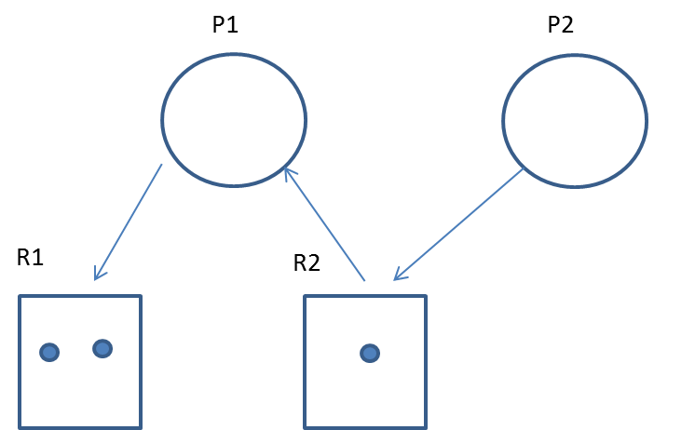
Resource-Allocation Graph (Cont.)
An edge between two nodes can be of two types:
  Request edge -- Allocation edge
Requesting
Requesting
Allocated
Operating System Concepts

Slide 11

Example of a Resource Allocation Graph (Deadlock???)
requesting
Allocated
Free
Operating System Concepts

Slide 12

Resource Allocation Graph (Deadlock ???)
Operating System Concepts

Slide 13

Resource Allocation Graph (Deadlock ???)
P1→R1→P3→R2→P1
Operating System Concepts

Slide 14
Basic Facts
Cycle is there: P1→R1→P3→R2→P1
But, there is no deadlock. Process P4 may release its instance of resource type R2. That resource can then be allocated to P3, breaking the cycle.
If graph contains no cycles ⇒ no deadlock.
If graph contains a cycle ⇒
  if only one instance per resource type, then deadlock.
  if several instances per resource type, possibility of deadlock.
Operating System Concepts

Slide 15
Methods for Handling Deadlocks
Ensure that the system will never enter a deadlock state.
Allow the system to enter a deadlock state and then recover.
Ignore the problem and pretend that deadlocks never occur in the system; used by most operating systems, including UNIX.
Operating System Concepts

Slide 16
Deadlock Strategies
The deadlock problem is handled by using the following strategies:
  Deadlock detection
  Deadlock prevention
  Deadlock avoidance
Operating System Concepts

Slide 17
Deadlock Prevention
Restrain the ways request can be made.
Mutual Exclusion – not required for sharable resources; must hold for non-sharable resources example. printer.
Hold and Wait – must guarantee that whenever a process requests a resource, it does not hold any other resources.
  Require process to request and be allocated all its resources before it begins execution, or allow process to request resources only when the process has none.
  Low resource utilization; starvation possible.
Operating System Concepts

Slide 18
Deadlock Prevention (Cont.)
No Preemption –
  If a process that is holding some resources requests another resource that cannot be immediately allocated to it, then all resources currently being held are released.
  Preempted resources are added to the list of resources for which the process is waiting.
  Process will be restarted only when it can regain its old resources, as well as the new ones that it is requesting.
  Adopt a policy wherein the resources allocated to a process can be preempted by the operating system. However, sometimes cost of preemption becomes very high. For instance, the resources like printers, plotters, etc., should not be forcefully taken by the OS from an executing process. In contrast, preempting a CPU for a short duration is tolerable.
Circular Wait – impose a total ordering of all resource types, and require that each process requests resources in an increasing order of enumeration.
Operating System Concepts

Slide 19
Deadlock Avoidance
Requires that the system has some additional a priori information available.
Simplest and most useful model requires that each process declare the maximum number of resources of each type that it may need.
The deadlock-avoidance algorithm dynamically examines the resource-allocation state to ensure that there can never be a circular-wait condition.
Resource-allocation state is defined by the number of available and allocated resources, and the maximum demands of the processes.
Operating System Concepts

Slide 20

Operating System Concepts

Slide 21
Basic Facts
If a system is in safe state ⇒ no deadlocks.
If a system is in unsafe state ⇒ possibility of deadlock.
Avoidance ⇒ ensure that a system will never enter an unsafe state.
Operating System Concepts

Slide 22

Safe, unsafe , deadlock state spaces
Operating System Concepts

Slide 23
Safe State
When a process requests an available resource, system must decide if immediate allocation leaves the system in a safe state.
System is in safe state if there exists a safe sequence of all processes.
Sequence <P₁, P₂, …, P_{n}> is safe if for each P_{i}, the resources that Pi can still request can be satisfied by currently available resources + resources held by all the P_{j}, with j<i.
  If P_{i} ‘s resource needs are not immediately available, then P_{i} can wait until all P_{j} have finished.
  When P_{j} is finished, P_{i} can obtain needed resources, execute, return allocated resources, and terminate.
  When P_{i} terminates, P_{i+1} can obtain its needed resources, and so on.
Operating System Concepts

Slide 24
Resource-Allocation Graph Algorithm
Claim edge P_{i} R_{j} indicated that process P_{i} may request resource R_{j}; represented by a dashed line.
Claim edge converts to request edge when a process requests a resource.
When a resource is released by a process, assignment edge reconverts to a claim edge.
Resources must be claimed a priori in the system.
Operating System Concepts

Slide 25

Resource-Allocation Graph For Deadlock Avoidance
Claim
Claim
Operating System Concepts

Slide 26

A Resource-Allocation Graph
Allocated
Operating System Concepts

Slide 27
Banker’s Algorithm (the deadlock avoidance algorithm)
Multiple instances.
Each process must a priori claim maximum use.
When a process requests a resource it may have to wait.
When a process gets all its resources it must return them in a finite amount of time.
Operating System Concepts

Slide 28
Data Structures for the Banker’s Algorithm
Let n = number of processes, and m = number of resources types.
Available: Vector of length m. If available [j] = k, there are k instances of resource type R_{j} available.
Max: n x m matrix. If Max [i,j] = k, then process P_{i} may request at most k instances of resource type R_{j}.
Allocation: n x m matrix. If Allocation[i,j] = k then P_{i} is currently allocated k instances of R_{j.}
Need: n x m matrix. If Need[i,j] = k, then P_{i} may need k more instances of R_{j} to complete its task.
    Need [i,j] = Max[i,j] – Allocation [i,j].
Operating System Concepts

Slide 29
Safety Algorithm
1. Let Work and Finish be vectors of length m and n, respectively. Initialize:
      Work := Available
      Finish [i] = false for i - 1,2,3, …, n.
2. Find an i such that both:
  (a) Finish [i] = false
  (b) Need_{i} ≤ Work
  If no such i exists, go to step 4.
3. Work := Work + Allocation_{i}
Finish[i] := true
go to step 2.
4. If Finish [i] = true for all i, then the system is in a safe state.
Operating System Concepts

Slide 30
Resource-Request Algorithm for Process P_{i}
Request_{i} = request vector for process P_{i}. If Request_{i} [j] = k then process P_{i} wants k instances of resource type R_{j.}
  1. If Request_{i} ≤ Need_{i} go to step 2. Otherwise, raise error condition, since process has exceeded its maximum claim.
  2. If Request_{i} ≤ Available, go to step 3. Otherwise P_{i} must wait, since resources are not available.
  3. Pretend to allocate requested resources to P_{i} by modifying the state as follows:
      Available := Available = Request_{i};
      Allocation_{i} := Allocation_{i} + Request_{i};
      Need_{i} := Need_{i} – Request_{i;}
    If safe ⇒ the resources are allocated to P_{i}.
    If unsafe ⇒ P_{i} must wait, and the old resource-allocation state is restored
Operating System Concepts

Slide 31
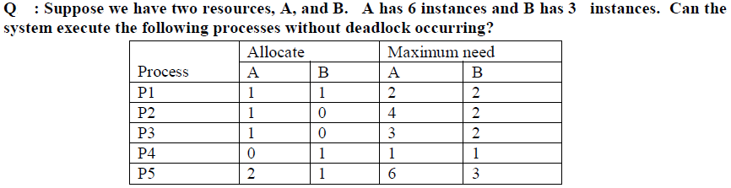
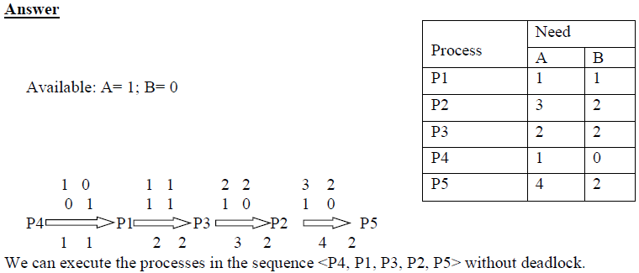
Example of Banker’s Algorithm
Sum of max. need per row.
Already Allocated
4
6
5
2
9
DONE….
Min.
Available: A → 6 instances, Already allocated → 5; available → 6-5 = 1; For B → 0
Total freed up resources can be allocated to awaiting processes.. Starting from P4 → P1 → P3 → P2 → P5…. Total can fulfill the need….
Need
Allocated
total
Operating System Concepts

Slide 32
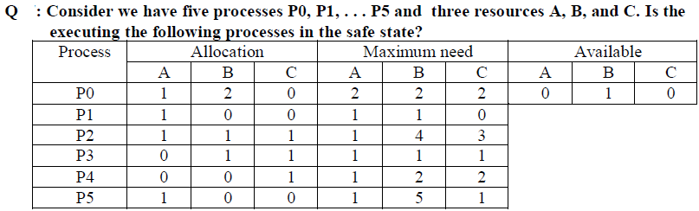
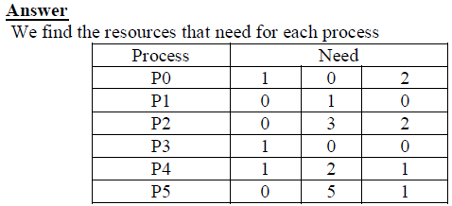
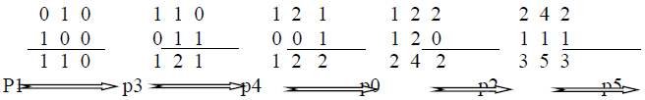
DONE….
Allocation
Operating System Concepts

Slide 33
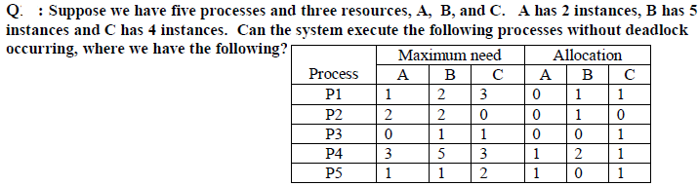
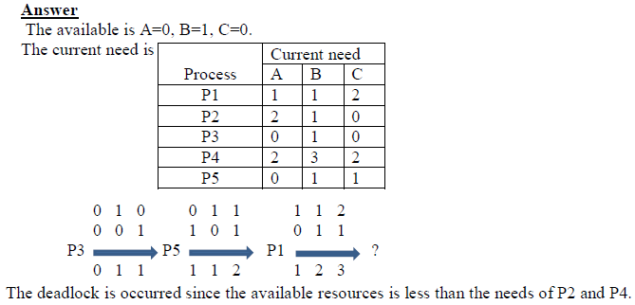
Try this….
Freed up resources
Available
For P2: freed up resources : 1 2 3
Allocation : 0 1 0
------------
1 3 3
Allocation
Operating System Concepts

Slide 34
Example of Banker’s Algorithm
5 processes P₀ through P₄; 3 resource types A (10 instances), B (5 instances), and C (7 instances).
Snapshot at time T₀:
Allocation Max Available
A B C A B C A B C
P₀ 0 1 0 7 5 3 3 3 2
P₁ 2 0 0 3 2 2
P₂ 3 0 2 9 0 2
P₃ 2 1 1 2 2 2
P₄ 0 0 2 4 3 3
Try this in H.W
Operating System Concepts

Slide 35
Example (Cont.)
The content of the matrix. Need is defined to be (Max – Allocation). Need
A B C
P₀ 7 4 3
P₁ 1 2 2
P₂ 6 0 0
P₃ 0 1 1
P₄ 4 3 1
The system is in a safe state since the sequence < P₁, P₃, P₄, P₂, P₀> satisfies safety criteria.
Try this in H.W
Operating System Concepts

Slide 36
Example (Cont.): P₁ request (1,0,2)
Check that Request ≤ Available (that is, (1,0,2) ≤ (3,3,2) ⇒ true.
Allocation Need Available
A B C A B C A B C
P₀ 0 1 0 7 4 3 2 3 0
P₁ 3 0 2 0 2 0
P₂ 3 0 1 6 0 0
P₃ 2 1 1 0 1 1
P₄ 0 0 2 4 3 1
Executing safety algorithm shows that sequence <P₁, P₃, P₄, P₀, P₂> satisfies safety requirement.
Can request for (3,3,0) by P₄ be granted?
Can request for (0,2,0) by P₀ be granted?
Try this in H.W
Operating System Concepts

Slide 37
Deadlock Detection
Allow system to enter deadlock state
Detection algorithm
Recovery scheme
Operating System Concepts

Slide 38
Single Instance of Each Resource Type
Maintain wait-for graph
  Nodes are processes.
  P_{i} → P_{j} if P_{i} is waiting for P_{j}.
Periodically invoke an algorithm that searches for a cycle in the graph.
An algorithm to detect a cycle in a graph requires an order of n² operations, where n is the number of vertices in the graph.
Operating System Concepts

Slide 39

Resource-Allocation Graph And Wait-for Graph
Resource-Allocation Graph
Corresponding wait-for graph
Operating System Concepts

Slide 40
Several Instances of a Resource Type
Available: A vector of length m indicates the number of available resources of each type.
Allocation: An n x m matrix defines the number of resources of each type currently allocated to each process.
Request: An n x m matrix indicates the current request of each process. If Request [ij] = k, then process P_{i} is requesting k more instances of resource type. R_{j}.
Operating System Concepts

Slide 41
Detection Algorithm
1. Let Work and Finish be vectors of length m and n, respectively Initialize:
  (a) Work :- Available
  (b) For i = 1,2, …, n, if Allocation_{i} ≠ 0, then
  Finish[i] := false ; otherwise, Finish[i] := true.
2. Find an index i such that both:
  (a) Finish[i] = false
  (b) Request_{i} ≤ Work
  If no such i exists, go to step 4.
Operating System Concepts

Slide 42
Detection Algorithm (Cont.)
3. Work := Work + Allocation_{i}
Finish[i] := true
go to step 2.
4. If Finish[i] = false, for some i, 1 ≤ i ≤ n, then the system is in deadlock state. Moreover, if Finish[i] = false, then P_{i} is deadlocked.
Algorithm requires an order of m x n² operations to detect whether
the system is in deadlocked state.
Operating System Concepts

Slide 43
Example of Detection Algorithm
Five processes P₀ through P₄; three resource types
A (7 instances), B (2 instances), and C (6 instances).
Snapshot at time T₀:
Allocation Request Available
A B C A B C A B C
P₀ 0 1 0 0 0 0 0 0 0
P₁ 2 0 0 2 0 2
P₂ 3 0 3 0 0 0
P₃ 2 1 1 1 0 0
P₄ 0 0 2 0 0 2
-------------------------------------------------------------
7 2 6
Sequence <P₀, P₂, P₃, P₁, P₄> will result in Finish[i] = true for all i. After completion of P0 and P2, we have different ways to arrange P3, P1 and P4. Try, (P1, P3, P4) or (P4, P1, P3) or (P3, P1, P4)……
No resources are available for P0 to P4 processes
Operating System Concepts

Slide 44
Example (Cont.)
P₂ requests an additional instance of type C.
Request
A B C
P₀ 0 0 0
P₁ 2 0 1
P₂ 0 0 1
P₃ 1 0 0
P₄ 0 0 2
State of system?
  Can reclaim resources held by process P₀, but insufficient resources to fulfill other processes; requests.
  Deadlock exists, consisting of processes P₁, P₂, P₃, and P₄.
Operating System Concepts

Slide 45
Detection-Algorithm Usage
When, and how often, to invoke depends on:
  How often a deadlock is likely to occur?
  How many processes will need to be rolled back?
    one for each disjoint cycle
If detection algorithm is invoked arbitrarily, there may be many cycles in the resource graph and so we would not be able to tell which of the many deadlocked processes “caused” the deadlock.
Operating System Concepts

Slide 46
Recovery from Deadlock: Process Termination
Abort all deadlocked processes.
Abort one process at a time until the deadlock cycle is eliminated.
In which order should we choose to abort?
  Priority of the process.
  How long process has computed, and how much longer to completion.
  Resources the process has used.
  Resources process needs to complete.
  How many processes will need to be terminated.
  Is process interactive or batch?
Operating System Concepts

Slide 47
Recovery from Deadlock: Resource Preemption
Selecting a victim – minimize cost.
Rollback – return to some safe state, restart process from that state.
Starvation – same process may always be picked as victim, include number of rollback in cost factor.
Operating System Concepts

Slide 48
Combined Approach to Deadlock Handling
Combine the three basic approaches
  prevention
  avoidance
  detection
allowing the use of the optimal approach for each of resources in the system.
Partition resources into hierarchically ordered classes.
Use most appropriate technique for handling deadlocks within each class.
Operating System Concepts

Slide 49

CSEN3103/ Sec-A/NB
6.<number>

